Slide 1

Housekeeper
Scheduling System
230 Java SL AK RLL - Group 6

Slide 2

Team Lead:- Hariprakash G
Group Members:-
1.Bethamsetty Vamsi krishna Saisrinivas
2.Boda Keerthana
3.Chandan Kumar
4.Dhaneshwaran Chandra Mohan
5.Dachepally Kiran
6.Hariprakash G
7.Karthik V

Slide 3

CONTENTS:
Abstract
Tools & Technologies
Project Architecture
Admin Modules
User Modules
ER Diagram
Database Schema
Module explanation
Output
Advantages
Conclusion

Slide 4

Abstract :
The HOUSEKEEPER SCHEDULING SYSTEM is designed to ensure timely room cleaning for hostel students.
Admin selects housekeepers, assigns specific requests from students, and can register new housekeepers based on floor no.
The system manages housekeeper details, including name, hostel, floor, rooms cleaned, and feedback.
It also maintains user feedback and request status, enhancing efficiency and communication within the hostel environment.

Slide 5




Tools & Technologies:
Front-End : Angular
Back-end : Spring Boot
Database : MYSQL , Hibernate
Server : Tomcat

Slide 6
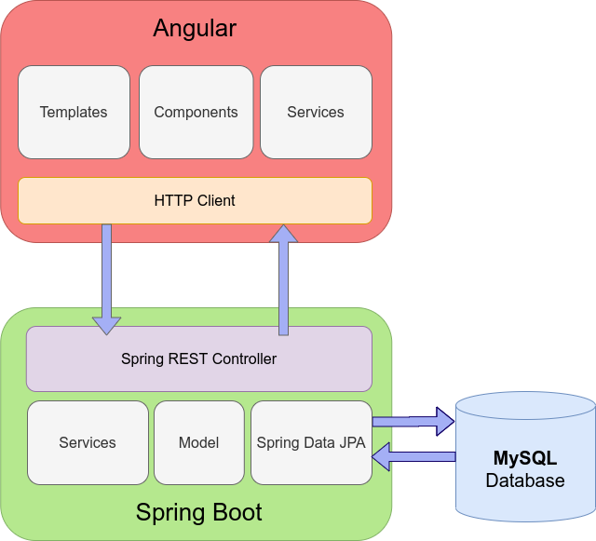
Project Architecture:

Slide 7

ADMIN Modules:
Login
Dashboard
Allot
Register Student
Register Housekeeper
Feedback
Logout

Slide 8

User Module:
Login
Dashboard
Requests
Feedback
Profile
Logout

Slide 9
ER Diagram:-
A class diagram is the visual structure of a system or application in terms of its classes, attributes, methods, and the relationships between them.
Feedback
Worker
Feedback _id
Roll_no
Worker_
id
name
Feedback
Req_id
Hostel
Floor
Sends
feedback
Selects
House
keeper
Sends
Request
Request complete
Allots
House
keeper
Clean request
Roll_
number
Admin
Student
Request_
id
Roll
number
password
Clean_ time
Request_
status
admin_
id
Username
Floor
Hostel
room
Date
Feedback_ Status
Worker_
id
hostel
Password

Slide 10
Database Schema:-
Student
Roll_number (PK)
floor
hostel
room
password
Clean_Requests
requestID (PK)
clean_time
date
Feedback_status
request_status
roll_number (FK)
worker_id (FK)
1
N
1
1
1
N
Feedback
feedback_id (PK)
feedback
requestID (FK)
roll_number (FK)
N
N
1
1
Admin
admin_id (PK)
hostel
username
password
Worker
worker_id (PK)
name
floor
hostel
1
N

Slide 11
Admin Login & Student Login-Frontend
Admin Login:
Displays the User Name and Password fields
Displays the Login Button for admin.
Displays the Student Login Button.
Student Login:
Displays the Roll Number and Password fields
Displays the Login Button for Student
Displays the Admin Login Button

Slide 12
Navbar (Frontend)
Navigation bar : It is UI used to provide navigation menus in a web application.It typically appears at the top of a webpage and contains links that allow Admin to navigate to different sections of the application.
Dashboard: Navigates to the admin dashboard home page.
Allot: This button is disabled and represents the functionality related to clean request allotment, It enabled when clean request applicable.
Feedback: Navigates to the feedback section where admin can view and manage feedback.
Register Student: Navigates to the page for registering a new student.
Register Housekeeper: Navigates to the page for registering a new housekeeper.
Logout: Executes the logout() function when clicked, used to log out the admin user.
Clean Requests: Displays the count of clean requests,indicating how many cleaning requests have been submitted by student
Feedback: Displays the count of feedback received from hostel students.

Slide 13
Dashboard-Frontend
ADMIN DASHBOARD:
It is used to view all the requests sent by the students based on room no ,date and time .
If user sends a request then under housekeeper allot button will appear which will navigate to allot bar.
The status will be blank until student sends the feedback.
Once the feedback is received from the students the status will become completed.

Slide 14
Module: Allot (Frontend)
Allot will get activated only when there is request made by the students.
Once there is a request made by the student the allot button will appear under housekeeper column in dashboard.
Clicking on the button will activate the allot tab in the side nav bar.
Now the admin can view the request id ,room no, and time requested by student
The admin can allot the housekeeper based on the floor from where the request has come

Slide 15
House keeper , logout(Frontend)
In this module admin will be able to register the housekeeper.
Admin will register the housekeeper by name and the floor
In the backend the worker will be assigned with a ID and the hostel he belongs automatically
So when admin allots a housekeeper for a request he can get the available workers on that particular floor.
After all the process is over admin/student can logout which will take him to admin/student login page.

Slide 16
Register Student ,change password (Front end)
Admin can register student in this module.
Admin can give roll number for student ,room no and floor to register the student .
After clicking submit the values will be stored in the database along with the hostel name and password.
At initial the password will be same as roll number which student can change .
In the student side the student can change his password
When he clicks on change password button a popup appears and there will be fields to write current password ,new password and confirm password, and on change it will change the students password in the backend

Slide 17
Student Navbar (Frontend)
Navigation bar : It is UI used to provide navigation menus in a web application . It typically appears at the top of a webpage and contains links that allow Admin to navigate to different sections of the application.
Dashboard: Navigates to the student dashboard home page.
Request: Navigates to the students clean request page
Feedback: Navigates to the feedback section where student can give feedback.
Profile: Navigates to students profile
Logout: Executes the logout() function when clicked, used to log out the admin user.

Slide 18
User-Dashboard:
In the user dashboard students can view the list of clean requests made by the roll number .
He can view housekeeper , date ,time and feedback status
If the housekeeper is allotted then it will show housekeeper name under the housekeeper column, if not allotted the it will display a message not allotted.
And after the housekeeper is allotted for a request the feedback button will appear under feedback column after giving the feedback the feedback status under the feedback column will become feedback sent

Slide 19
Frontend Clean request , update profile:
The clean request module is for student side.
The user the can place the clean request based on which time and date he needs the cleaning to be done and he can submit the request to admin of the hostel based on which admin will allot the housekeeper.
Update profile is a functionality inside the student profile where there is change password of student also. So update profile is used to update students hostel , room no and floor no based on the roll number of the student.

Slide 20
Feedback-Frontend
The feedback button will get enabled only when the admin allots the housekeeper for the particular clean request student makes.
When the feedback button becomes active he can give feedback for the housekeeper.
In the admin side the clean request status will become complete only when the feedback is sent by the student.
Admin can view all the feedbacks received under feedback tab.

Slide 21
Admin Login ,Allot (Backend)
Admin login module : Managing administrative operations related to an entity called "Admin." It handles creating,
retrieving, and checking admin entities using appropriate HTTP endpoints.
Save Admin: It is used to save admin details with admin_id , username , Password and hostel details.
Get All Admins: It retrieves a list of all admin.
Check Admin Login: It takes an Admin object in the request body, checks if the provided admin credentials are valid or not
Get Admin by ID: It takes an admin ID , fetches the corresponding admin
Allot Housekeeper to Cleaning Request
Links a housekeeper (worker) to a cleaning request, marking it as completed.

Slide 22
Module: Student (Backend)
Student module: Managing administrative operations related to an entity called “Student." It handles creating,
retrieving, and checking student entities using appropriate HTTP endpoints.
Save Student: It is used to save student details with roll number, name, password, floor, and hostel details.
Get All Student: It retrieves a list of all students.
Check Student Login: It takes a Student object in the request body, checks if the provided student credentials are valid or not
Get Student by ID: It takes a student roll number , and fetches the corresponding student.
Change Password of the Student:, It is used to change the password of a student.

Slide 23
Module: House keeper(Backend)
Register housekeeper: It is used to save the housekeeper details.
Get housekeeper by floor: It is used to get the housekeeper by floor no and hostel.
Get housekeeper by ID : It is used to find housekeeper by ID

Slide 24
Clean request module(backend)
Submit Cleaning Request.
When a POST request is made, it links the request with a specific student using their roll number.
Get Request Count
Retrieves the number of cleaning requests made by a student based on their roll number.
Get Cleaning Requests by Student
Retrieves a list of all cleaning requests associated with a student based on their roll number

Slide 25
Contd..
Get All Cleaning Requests by Hostel
Retrieves a list of all cleaning requests made for a particular hostel.
Get Cleaning Request Count by Hostel
Retrieves the number of cleaning requests made for a specific hostel.
Get Cleaning Request by ID
Retrieves a cleaning request based on its unique identifier (ID).

Slide 26
Module-Feedback(Backend)
Submit feedback:
This functionality allows a user (presumably a student) to submit feedback for a specific clean request.
Get Feedback Count for a Hostel:
This functionality retrieves the count of feedback submissions for a specific hostel.
Get Feedback Count by Student Roll Number:
This functionality retrieves the count of feedback submissions for a specific student using their roll number.
Get All Feedback for a Hostel:
This functionality retrieves all feedback submissions for a specific hostel.

Slide 27
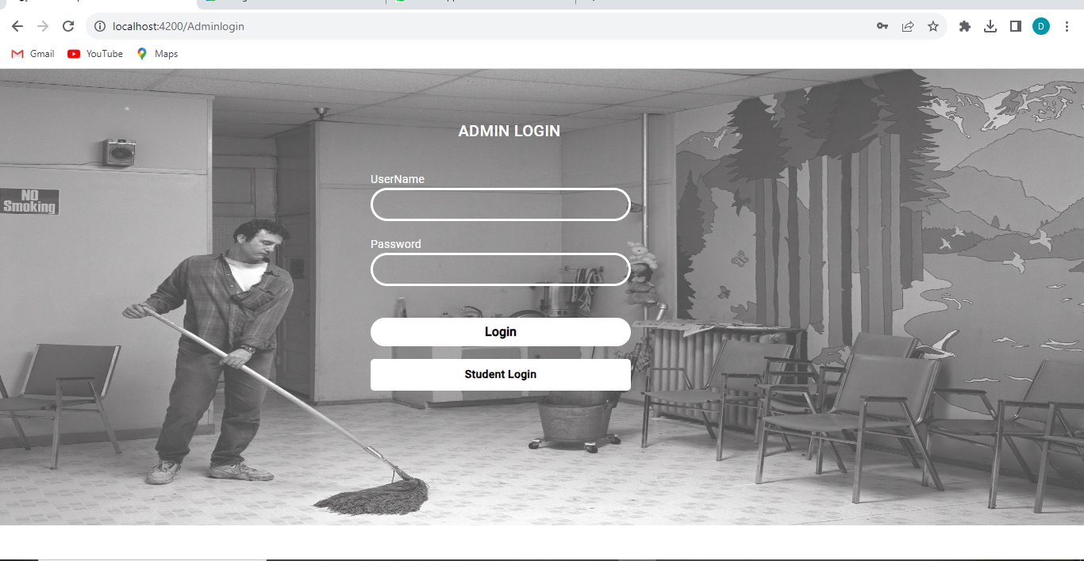
Admin side : scrEenshots Admin login

Slide 28
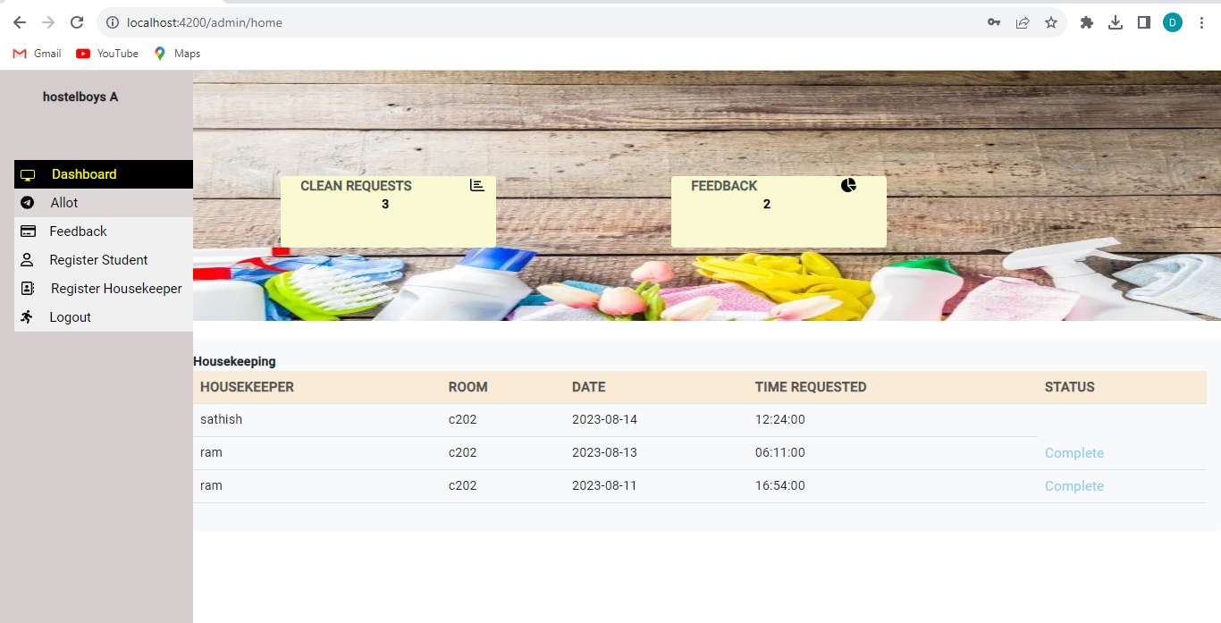
Admin dashboard

Slide 29
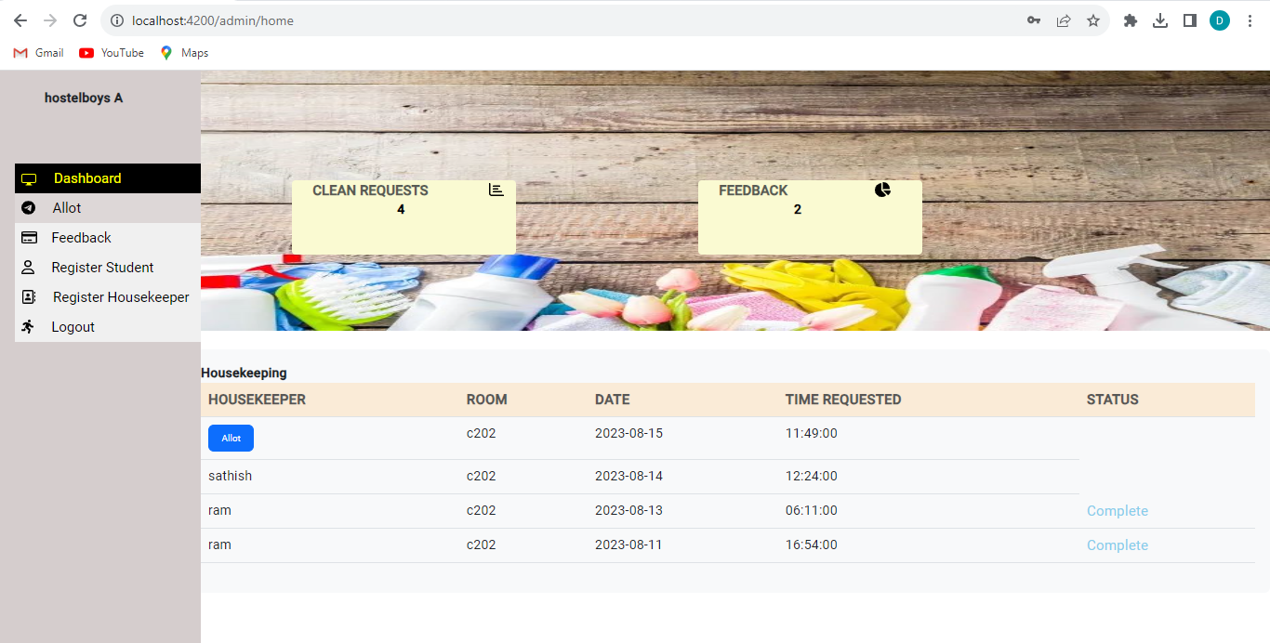
Admin allot:

Slide 30
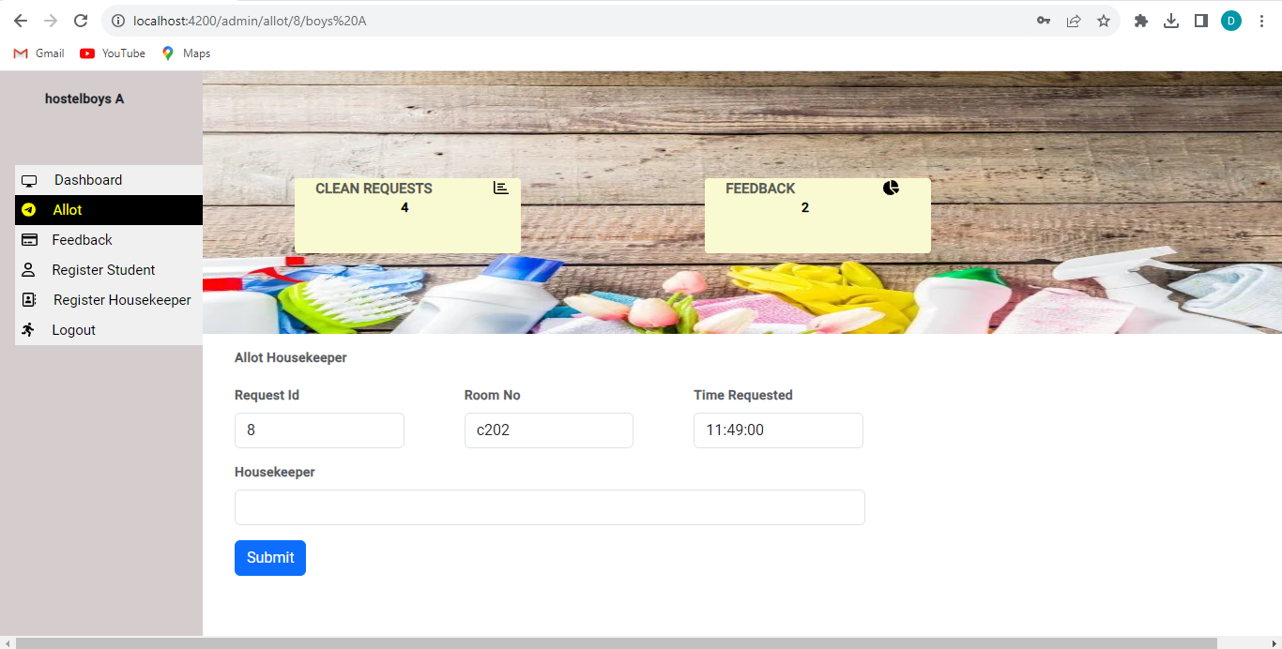
Admin allot:

Slide 31
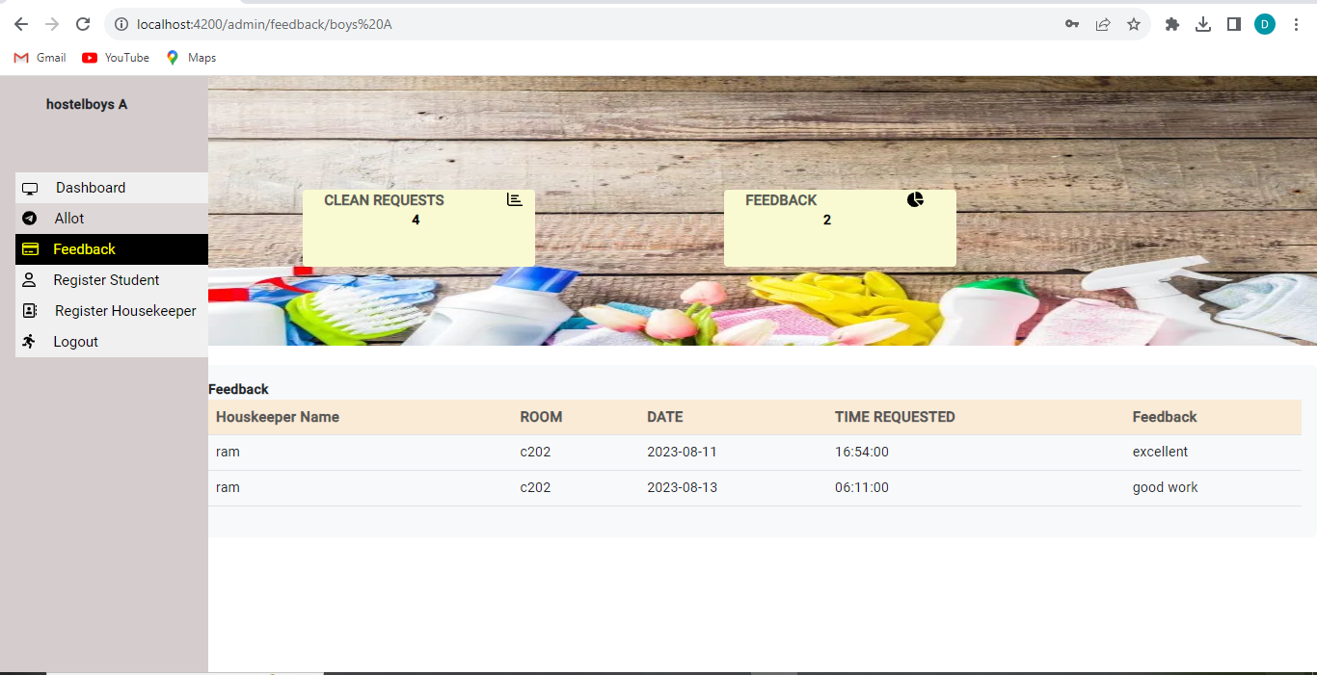
Admin view feedback

Slide 32
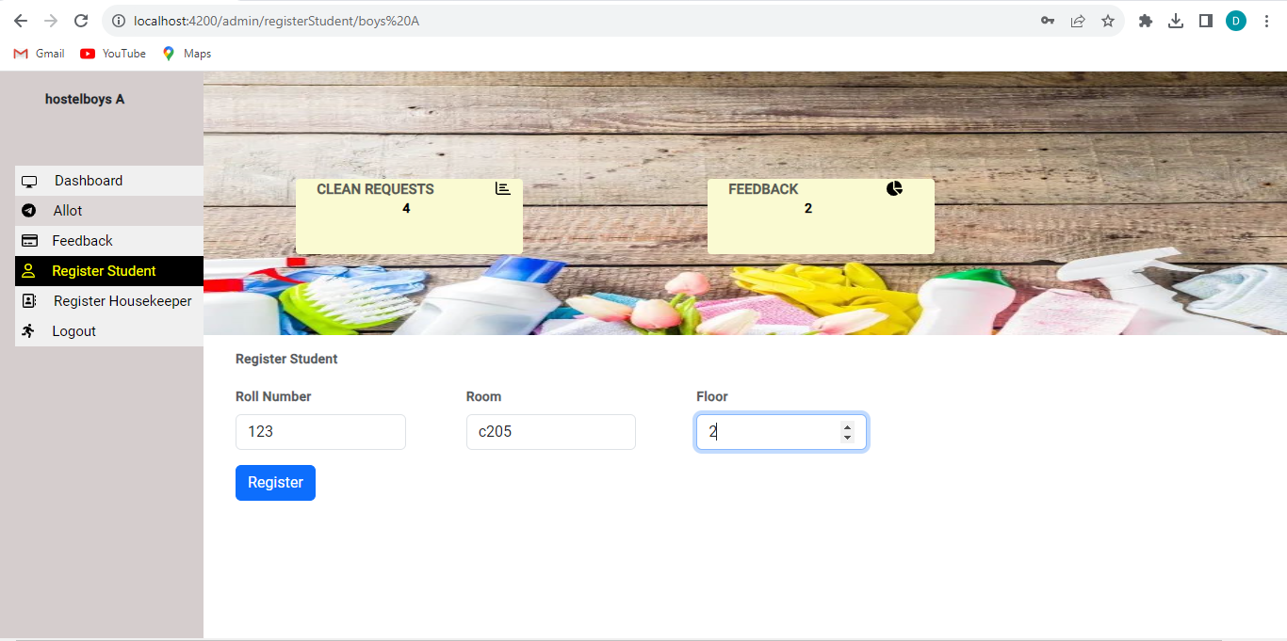
Admin student register

Slide 33
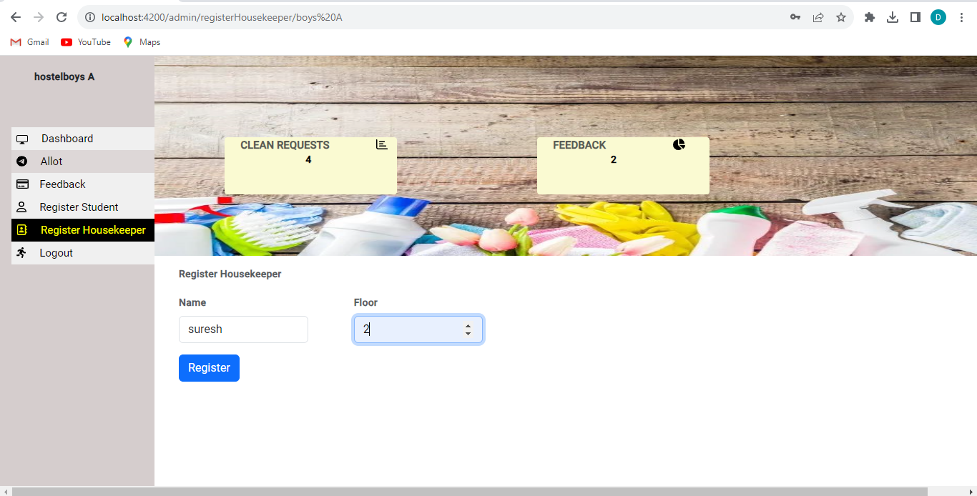
Admin housekeeper register:

Slide 34
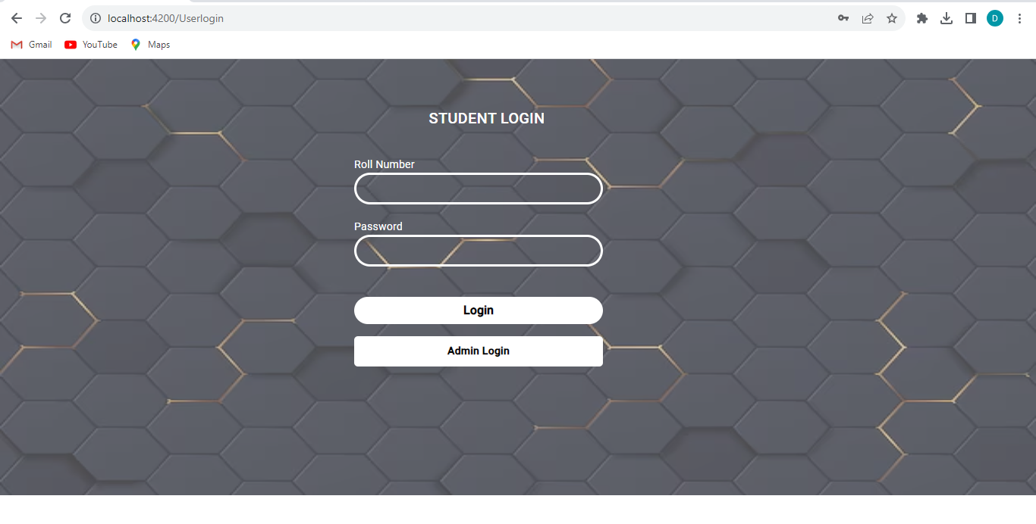
Student login:

Slide 35
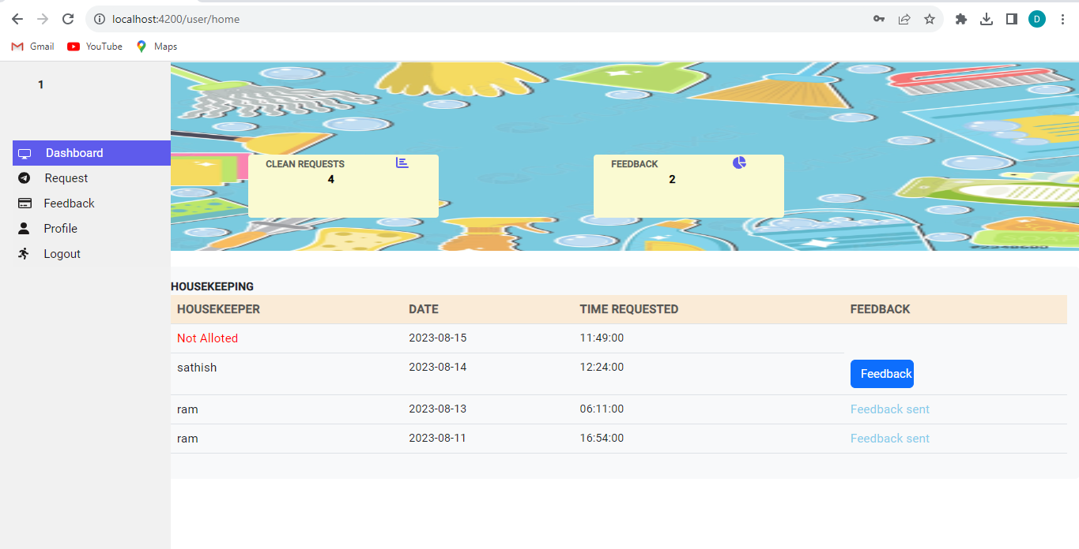
Student dashboard:

Slide 36
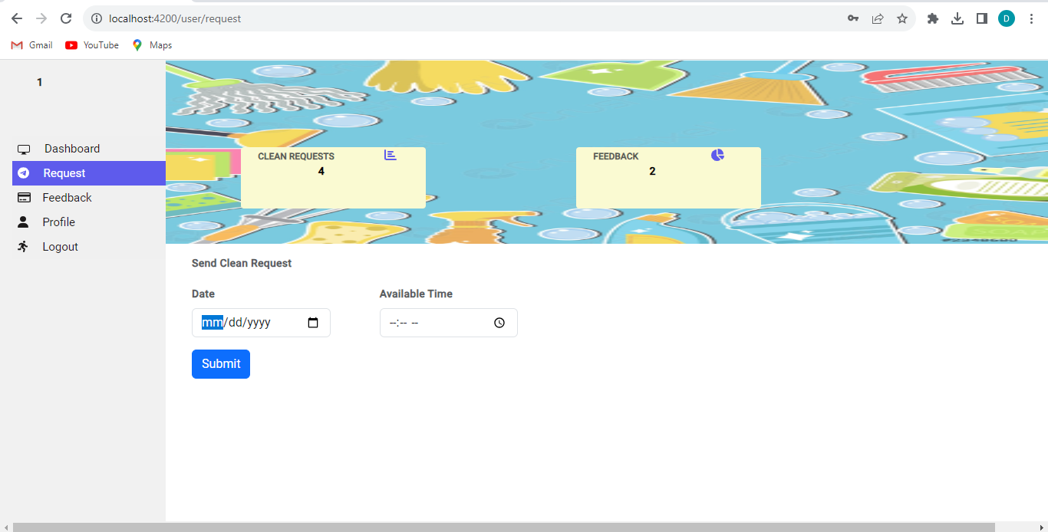
Student clean request:

Slide 37
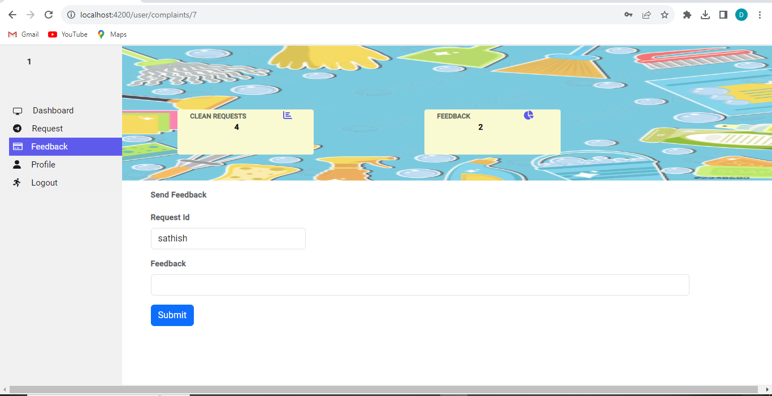
Student feedback:

Slide 38
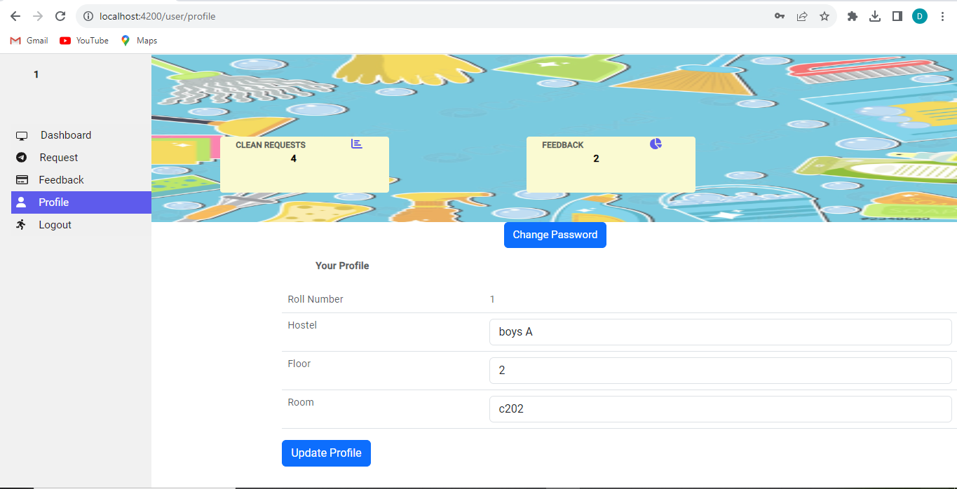
Student update profile:

Slide 39
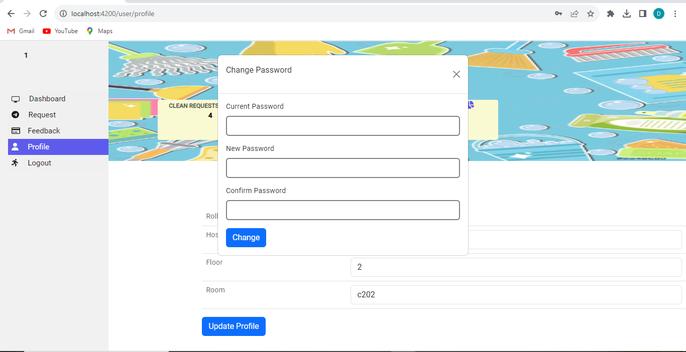
Student change password:

Slide 40
Advantages:-
This system is very easy to understand and user friendly.
This system is saving the time for student and hostel warden too.
In this system user can connect any time whenever he/she wants.

Slide 41
Conclusion:-
This project exemplifies the power of technology in transforming traditional processes and creating a more convenient and effective environment for both students and hostel management.
From the management's perspective, this application will enhance the efficiency of cleaning service utilization, reducing the occurrence of improper scheduling and optimizing resource allocation.
The application's rich features will empower students to easily request cleaning services, select preferred time slots, and receive timely notifications and updates regarding the cleaning process.

